Slide 1
Hospital management for rare diseases
Martina Galán, Blanca Pueche, Celia Pérez, Elena Marco

Slide 2
Index
01
04
02
05
03
Introduction
Use cases
Functionality
Video
ER Diagram and UML

Slide 3

01. Main idea
Due to long waiting times to treat rare diseases.
Low understanding of these diseases.
Designed for sorting medics to sort, register and deliver patients and to organize doctor.

Slide 4
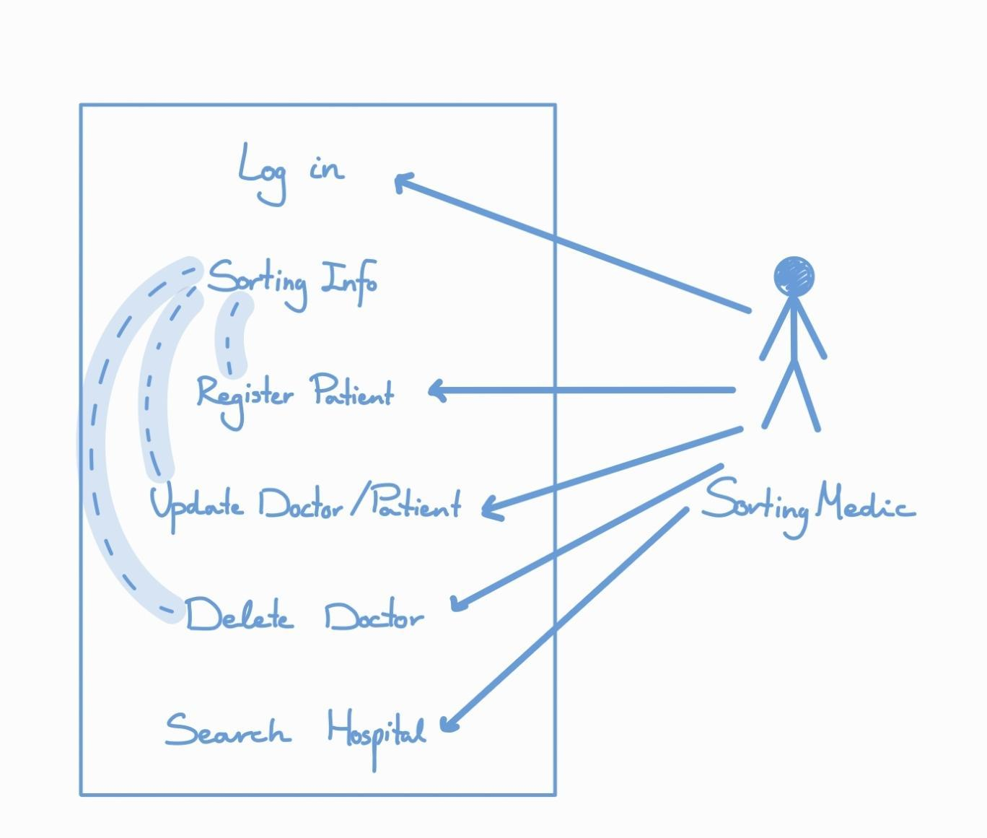
02. Functionality
Log in.
Sorting
Register
Update
Delete
Search for hospitals

Slide 5
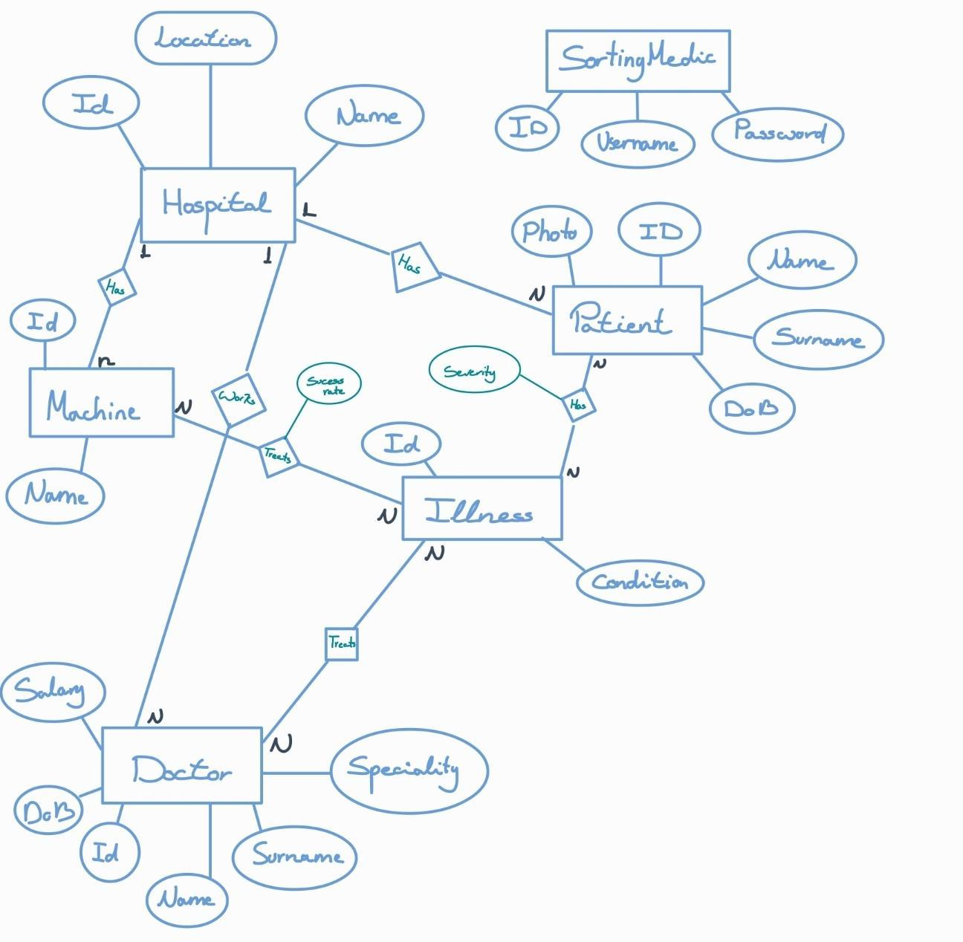
03. ER Diagram and UML

Slide 6
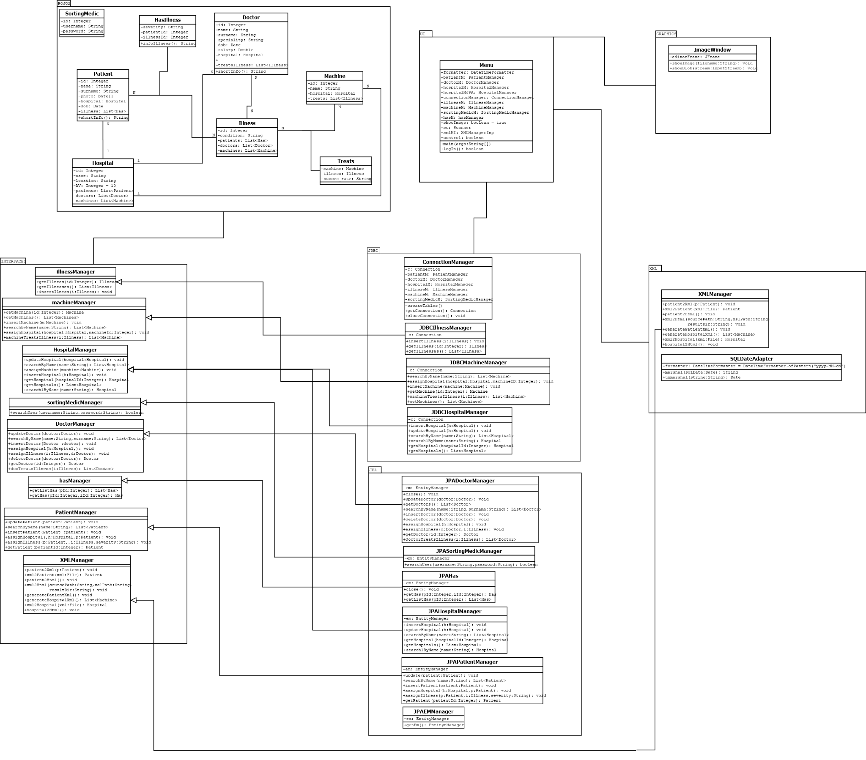
UML

Slide 10
04. Use cases
01
02
03
Log in
Select a doctor
Register a Patient
Description: sorting medic types their information as user and password
Precondition: the sorting medic must have an account
Standard Scenario:
1. The sorting medic types their user and password
Postcondition: The sorting medic has access to the app
Description: search for the data of the doctor
Precondition: the sorting medic must have logged in and the doctor must be in the database
Standard Scenario:
1. input the name and surname of the doctor into the search bar
2.the app shows a list of doctors with the same name and surname and asks for the id
3. input the id of the doctor we want to select
Postcondition: Three options show up, “show data” “update data” “delete doctor”
Description: input the data of the patient
Precondition: the sorting doctor must have logged in
Standard Scenario:
1. Sorting medic writes patient data
2. App shows a list of illnesses to choose from
3. Sorting medic selects illness
4. Sorting medic add the severity of this illness
Postcondition: Patient data added

Slide 11
04. Use cases
04
05
Update patient
Start search for hospital
Description: replace the old data of the patient for new one
Precondition: sorting medic must have logged in and a patient must have been selected
Standard Scenario:
1. App shows patient selected menu
2. Sorting medic selects update option
3. Sorting medic changes patient data or presses enter if there is a field we don’t want changed.
4. App asks if we want to change the illness severity
5. If yes, app shows the illnesses the patient has and asks for the illness we want updated
6. Sorting medic enters new severity
Postcondition: patient data updated
Description: Once the patient data is on the app, the sorting medic selects the option to search for a hospital according to the patient data (illness) and the availability of the hospital
Precondition: the sorting medic must have logged in and the patient must have been selected
Standard Scenario:
1.app shows the list of illnesses of the patient and asks for the id of the illness we want to treat
2. sorting medic inputs the id of the illness
3. app checks doctors that treats that illness
4. app checks which machine treats that illness
5.app matches the machine and doctor to search for a hospital that has both
6.app checks for the availability of the hospital
7..app shows a hospital with the conditions required
Postcondition: the app has assigned a hospital to the patient

Slide 12
04. Use cases
1 Select a patient 6 Create a hospital XML
2 Update a doctor 7 Show patient data
3 Delete a doctor 8 Show a doctor data
4 Show Hospitals 9 Look for illness
5 Create a patient XML 10 Update illness severity

Slide 13

05. Video
Demonstration:
Update doctor
Delete doctor
Register patient
Show info patient and doctor
Search hospital for patient
Show hospitals

Slide 14
Search hospital function

Slide 15
Thank you for your attention!

